Slide 1
Instagram Advocte Classifier
Galvanize Capstone Project
by PJ Shetty

Slide 2

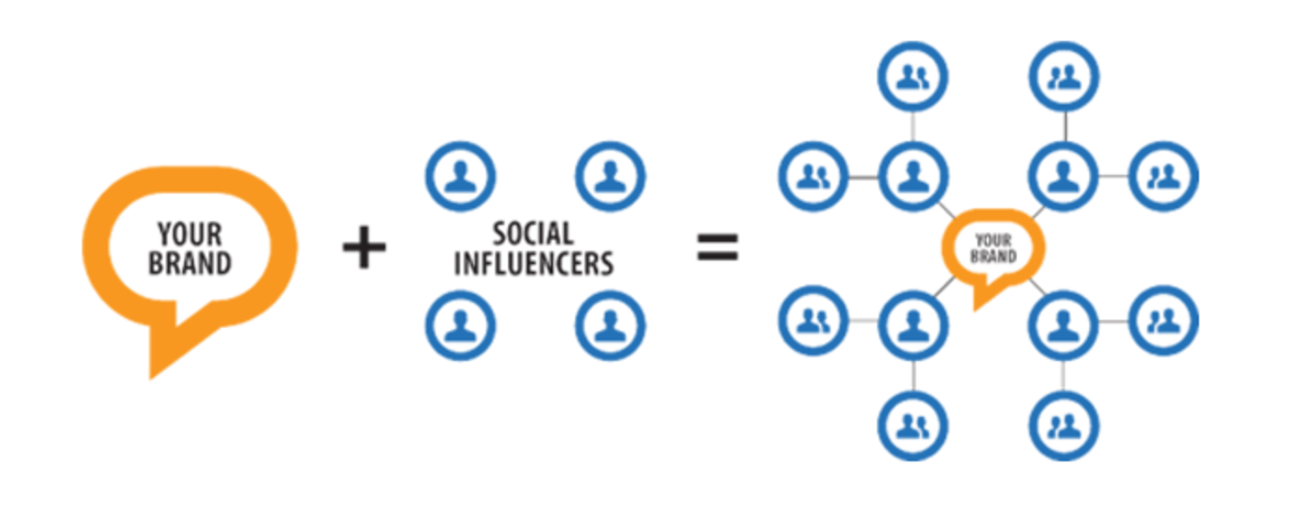
AdMass is an influencer marketing platform that helps advertisers find their advocates on social media.
YOUR
BRAND
SOCIAL INFLUENCERS
YOUR
BRAND

Slide 3
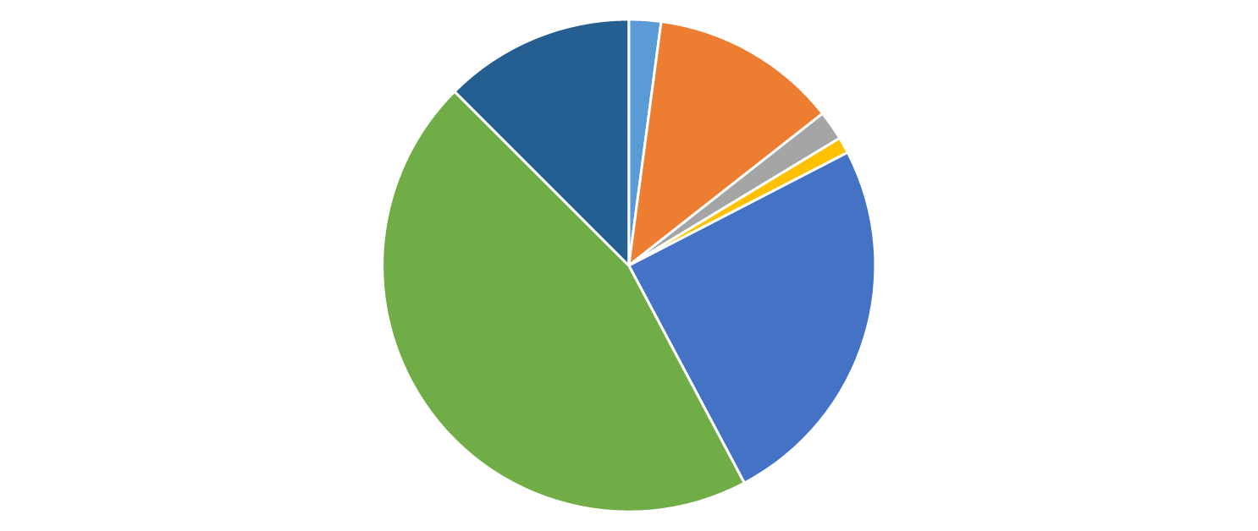
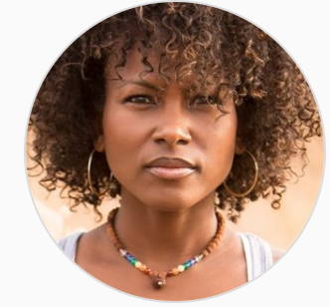
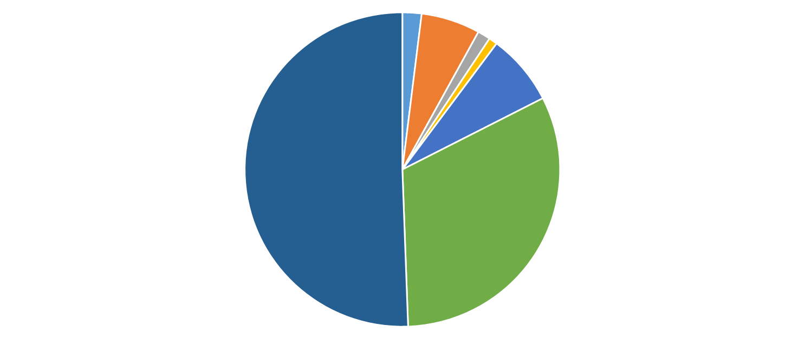

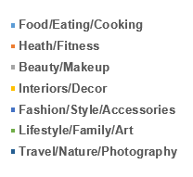
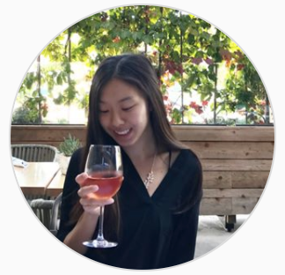
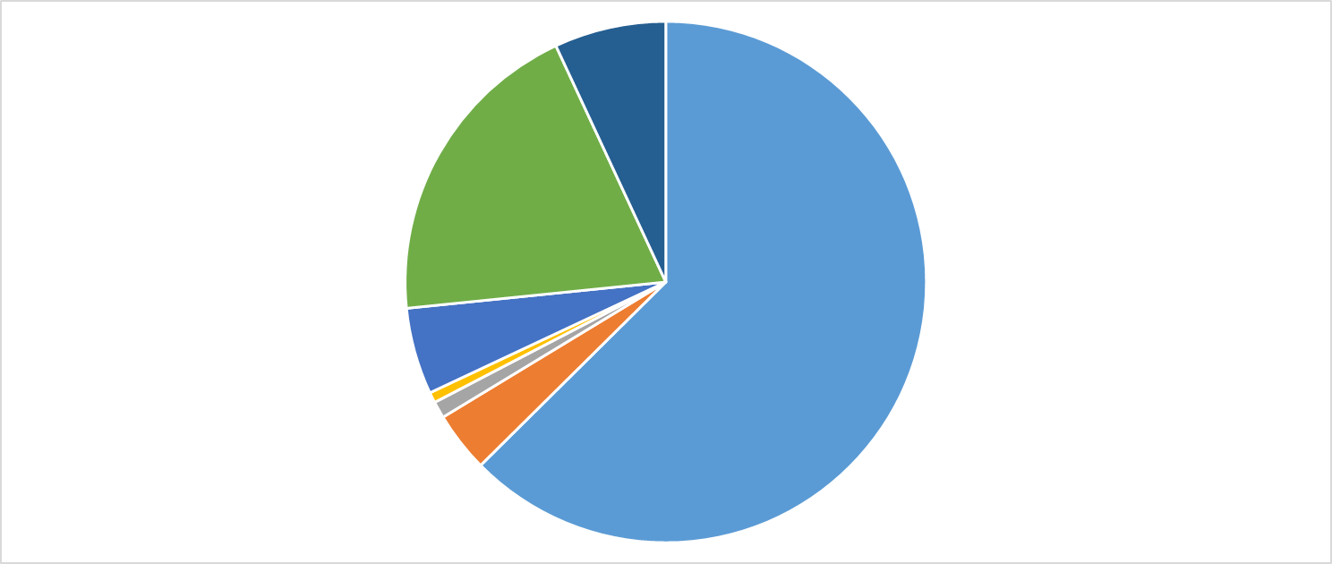
Categorize an Instagram Advocate based on their content
.
.
.
.
.
.
.

Slide 4


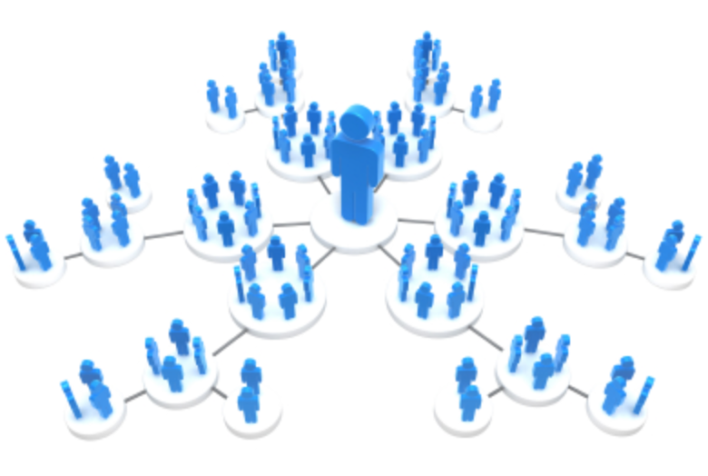
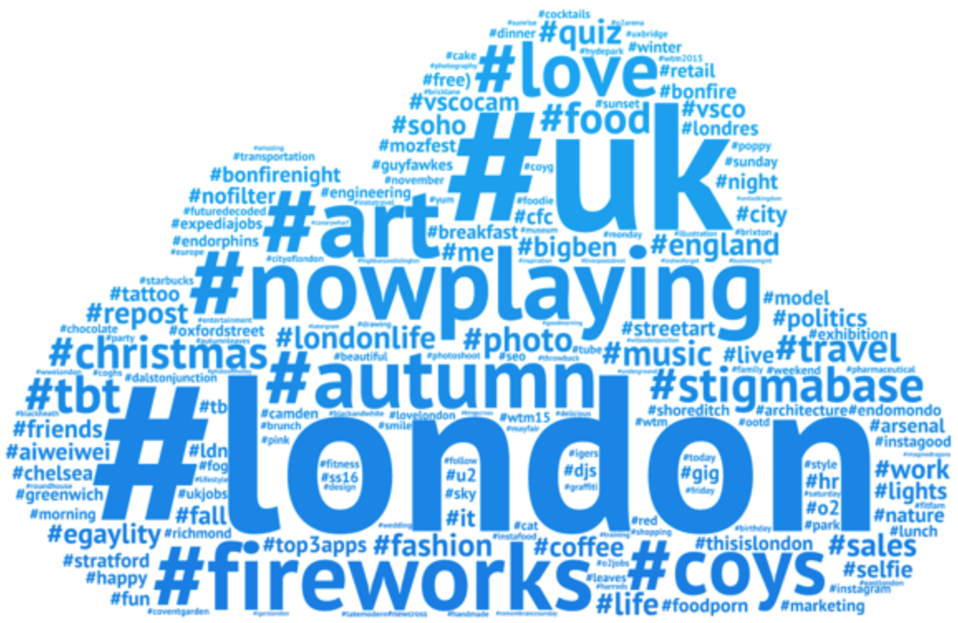
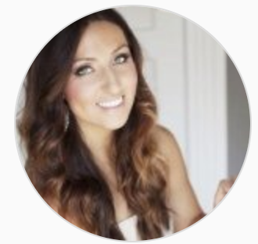
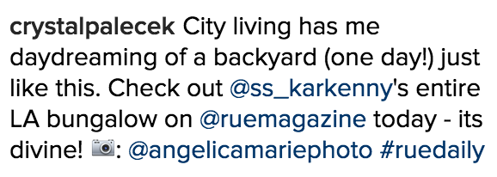
Data extraction
Followers
Hashtags
Bio
Captions

Slide 5
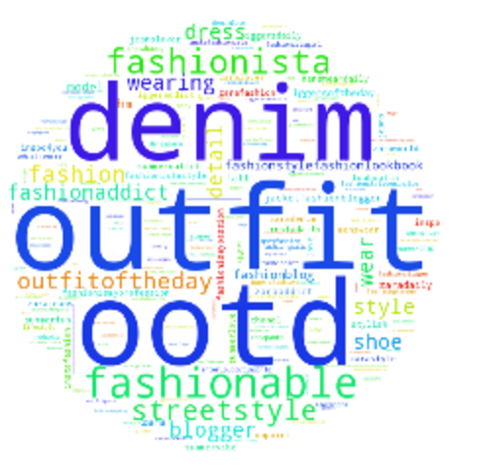
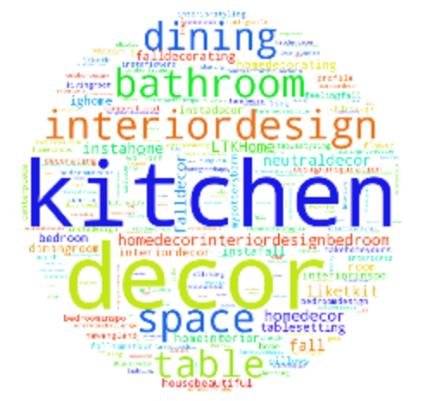
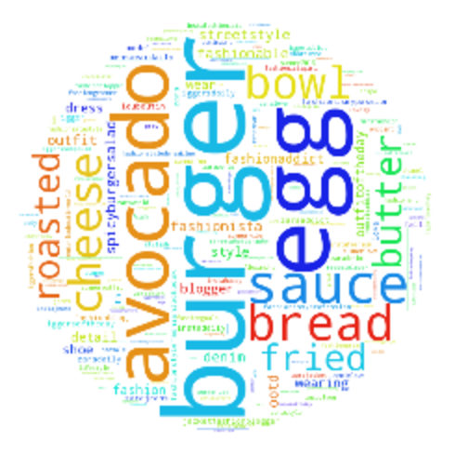
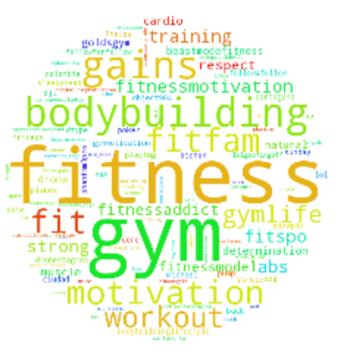
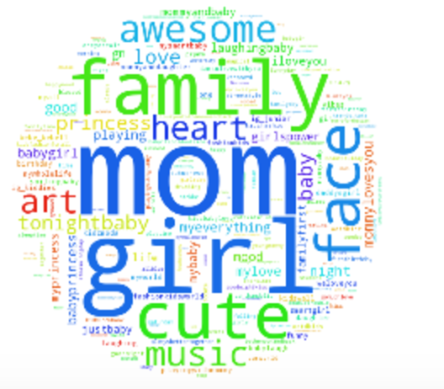
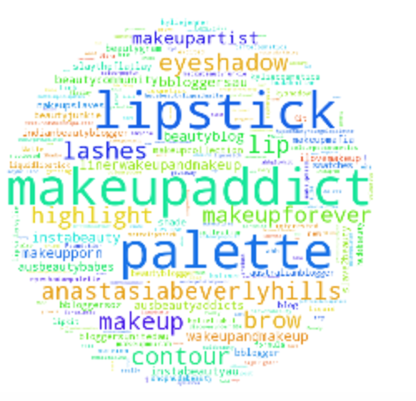
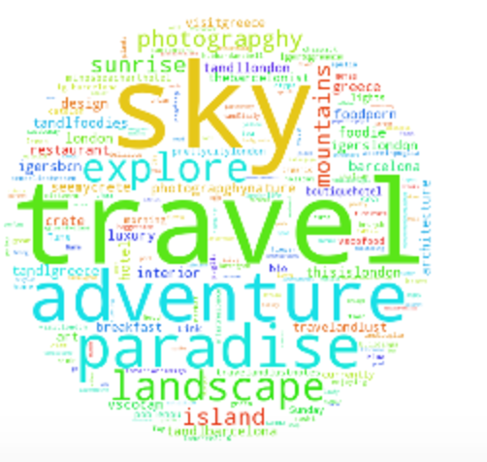
NLP
Bio, Captions, & Hashtags…
TF-IDF & K-means
CLUSTERS

Slide 6
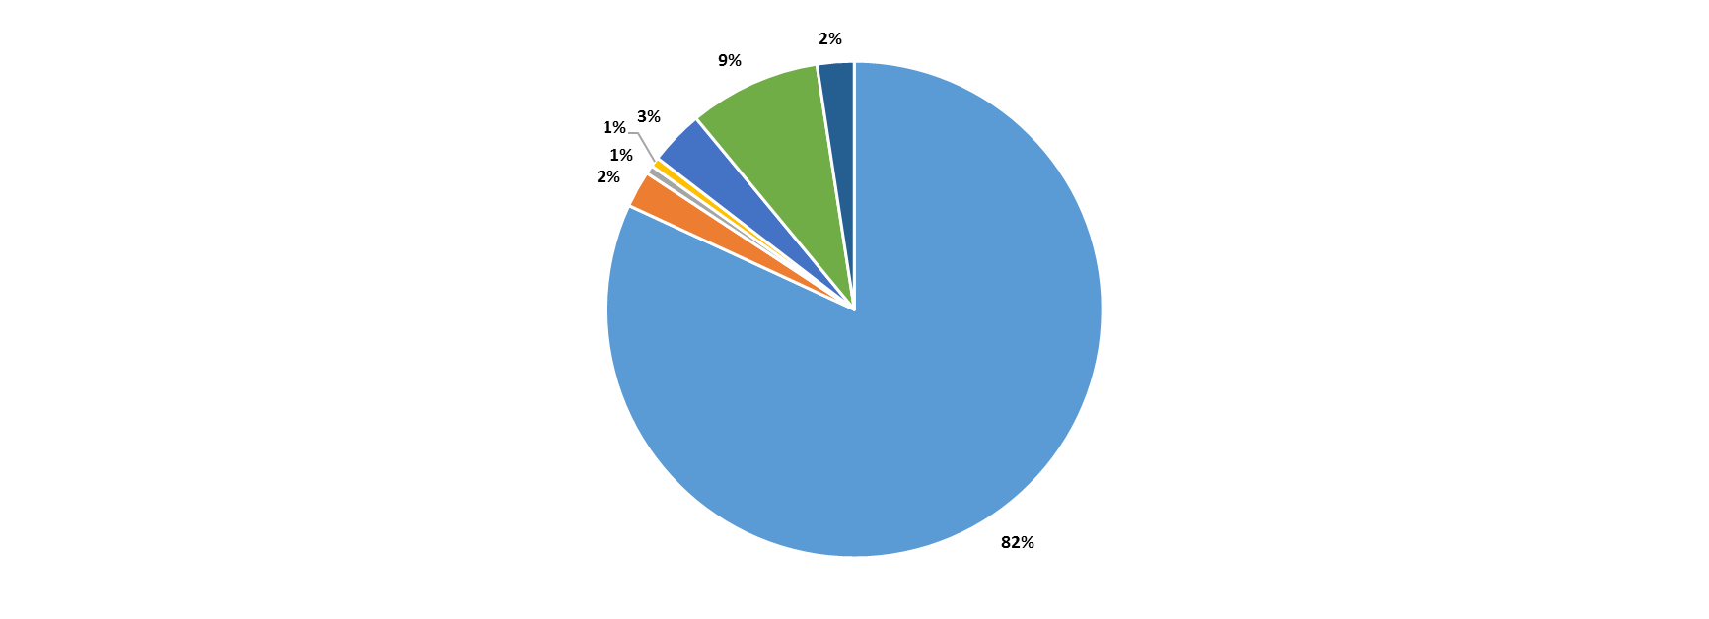
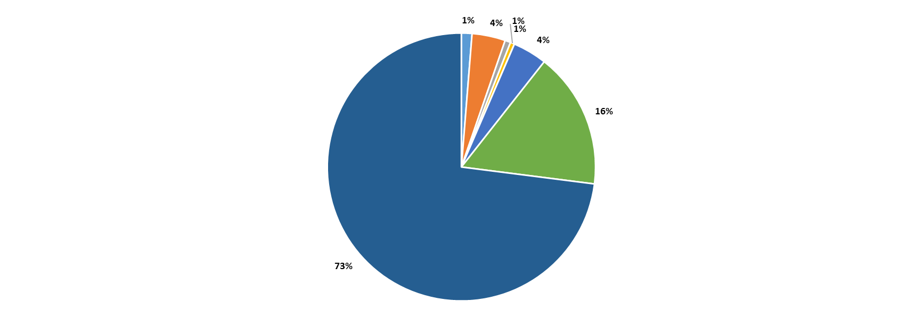
Model output
User | Food/Eating/Cooking | Heath/Fitness | Beauty/Makeup | Interiors/Decor | Fashion/Style/Accessories | Lifestyle/Family/Art | Travel/Nature/Photography
ryanbaccari | 0.10 | 0.40 | 0.10 | 0.04 | 97.10 | 1.75 | 0.52
kalejunkie | 81.89 | 2.38 | 0.56 | 0.62 | 3.56 | 8.58 | 2.42
sbdunkscarl | 1.27 | 4.02 | 0.68 | 0.50 | 4.13 | 16.42 | 72.99
ashleysdecorspace_ | 1.65 | 3.36 | 0.98 | 63.79 | 7.74 | 16.65 | 5.82
theaestheticsedit | 2.31 | 5.37 | 49.19 | 1.29 | 11.17 | 23.29 | 7.38
.
.
.
.
.
.
.

Slide 7
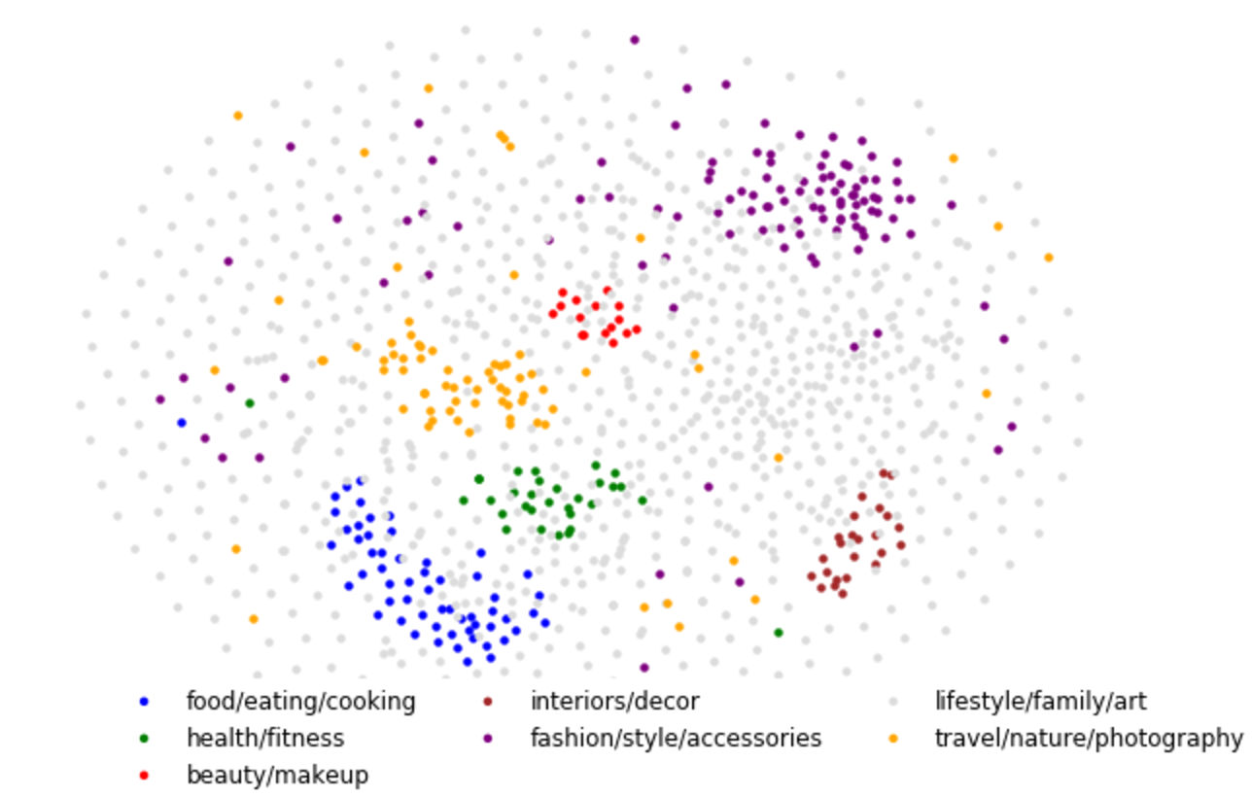
Instagram in 2D world
.
.
.
.
.
.
.

Slide 8

$$+$$
PJ Shetty
prabhanjan.shetty@gmail.com
https://www.linkedin.com/in/shettypj
https://github.com/pshetty44/Admass

